Slide 1
A paradox of non-verbal communication on the Internet: emoticons vs. reaction-gifs
Ágnes Veszelszki
5th Visual Learning Conference Pictures – Parables – Paradoxes
Budapest, Nov. 14–15, 2014

Slide 2
Overview
assumptions of linguistic research on digital communication
expressing emotions on the Internet
empirical research on reaction-gifs

Slide 3
1. Fundamental assumptions of linguistic research on digital communication

Slide 4
1.1. Technological determinism
various degrees of strength
constraints and affordances of the medium/technology determine (linguistic) behaviour
intention for pure technological determinism ~ universality and convergence of languages used on the Internet (Herring, Stein, Virtanen 2013)

Slide 5
1.2. Digital communication— a deficient or a new form?
netlinguistics (1980-1990s): comparison: online text to oral and written language
interactive register: dialogical elements in written communication
conceptual/medial literacy and orality
terms: pseudo-orality, written form of talks, secondary orality, symbolic literacy, new oral communication, virtual literacy
> oscillating

Slide 6
Explanation for structural features
early research:lack + compensation
”electronic contexts are often impoverished ones”
emoticons
performative action words: *wink*
abbreviations, acronyms, inflectives
ludic character of language, less strict norms, metalinguistic reflexion

Slide 7
2. visuality

Slide 8
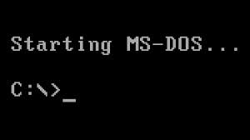
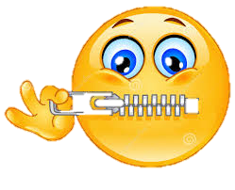
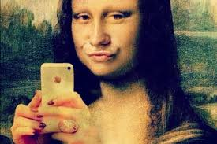
Examples for significance of visuality in ICT
profile pictures on social network sites
selfies
desktop panels of operation systems
pic-jokes and memes
emoticons
reaction-gifs

Slide 9
3. Non-verbal communication on the Internet

Slide 10
3.1. Verbal smileys and inflectives
semiotics:feelings
traditional written texts (personal letter): implicitly by symptoms
oh!
digital communication (chat): explicitly by conventional signals
performative action words: German *empfindsamsei* (~ *besensitive*)

Slide 11
Verbal smileys
phrases, expressions describing gestures, mimes
represent non-verbal signs in written form
descriptions of emotions in a rapid way
e.g. facepalm (smiley: m-( or m-/), double-facepalm, headdesk

Slide 12
Inflectives
English ‘sound words’
German translations of English comics: Erika Fuchs, translator, 1950s
infinite, non-conjugated verb forms
express movements and actions
e.g. German grins < grinsen ’to grin’, heul < heulen ’to yell’, dichknuddel < ich knuddele dich ’I cuddle/embrace you’
meta-linguistic elements: asterisks **

Slide 13
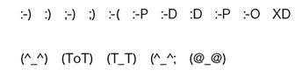
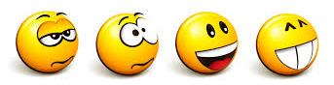
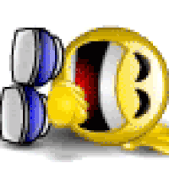
3.2. Emoticons
graphic signs, expressing emotions
text-image conglomerates
types
character combinations, punctuation marks
western
Japanese emoticons, emojis
graphic symbols
standing (static)
moving (dynamic)

Slide 14
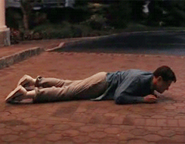
3.3. Reaction-gifs
moving pictures, a series of short movements
„Do you need to make a point? Say it with a gif. You can use a reaction gif in response to someone or something on the Internet.”
„Not sure what to say? Reply with a GIF. Worth more than a thousand words.”

Slide 15
4. Empirical study on reaction-gifs

Slide 16
Empirical research
usage of reaction-gifs
summer 2014
on-line questionnaire (research methodology: advantages + disadvantages)
voluntary participation, random sampling
pre-testing + recording informative data

Slide 17
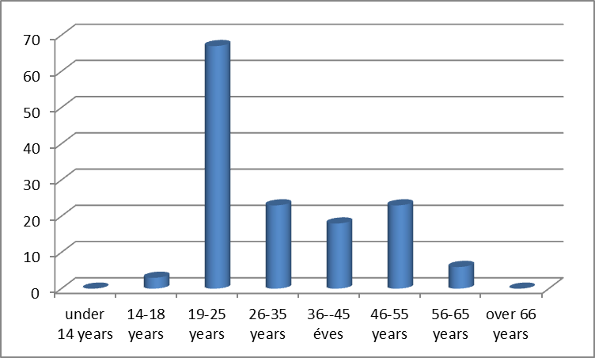
The sample
140 participants, native speakers of Hungarian
74% female, 26% male
age group 19-25 over-represented in the sample

Slide 18
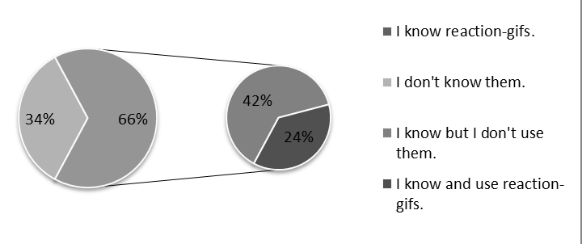
Knowledge & usage of reaction-gifs

Slide 19
Time spent on the net & knowledge of reaction-gifs

Slide 20
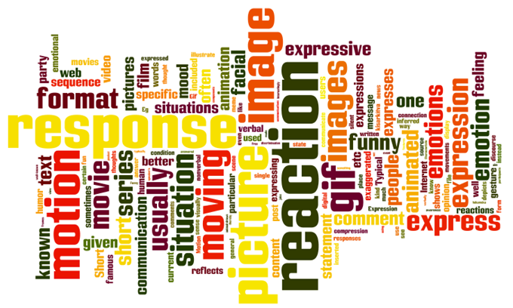
4.1. Definition of reaction-gifs

Slide 21
4.2. Pragmatic and sociolinguistic traits of using reaction-gifs
reasons or goals
the gif-answer is pertinent (69)
funny impact (60 respondents)
lack of non-verbal symbols in digital communication (32)
when an emoticon is not expressive enough (24)
when nothing to say in textual form (9)

Slide 22
Recipient (whether it is possible to send reaction-gifs to the recipient)
age of the partner (51)
the partner is used to send gifs (44)
relationship: familiarity & intimacy (34)
background knowledge
“I usually send gifs to those ones who do know the meaning of that particular gif, thus, besides the impact, the partner possessing some sort of background knowledge, the gif will have an extra effect on them”
“I don’t send them to a digital illiterate, as they won’t have a hint of what I want to mean by this”

Slide 23
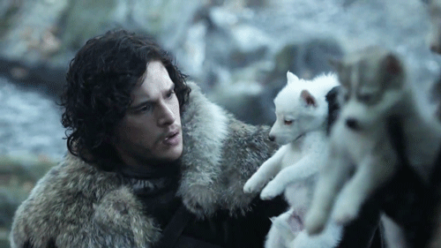
Important actors
characters of films or series (75)
public celebrities, politicians (61)
unknown people (49)
sportspeople (20)
e.g. Chuck Norris, Doctor Who, Garfield, Spiderman, The Lord of the Rings, Game of Thrones

Slide 24
Texts
Cool story bro gif
Oh my God
Look at all the fucks I give
Fuck yes
I don’t believe you
I'm drunk and I see my mom is coming to pick me up
facepalm

Slide 25
4.3. Occurrence of reaction-gifs
using: Facebook (57), anonymous imageboards, Tumblr, Viber, Plurk, Reddit, forums, funny websites (9gag, Hugelol), presentations
finding: Google search (49), gif-collecting websites (28), Facebook (25), 9gag (24), Tumblr (20), Reddit, 4chance, anonymous imageboards, by accident

Slide 26
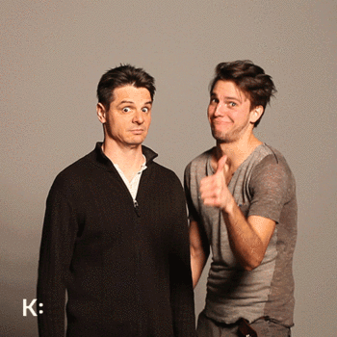
Occurence
gif-theatre
Hungarian József Katona Theatre, Budapest
“we express your emotions”
http://www.gifszinhaz.hu/
funny, like-collector websites
24 Things Single People Are Tired Of Hearing http://www.buzzfeed.com/ashleyperez/24-things-single-people-are-tired-of-hearing

Slide 27
Occurence
on-line press products
commenting the text visually
fragmenting the monotony and statics of verbal unity
shifting from formal articulation and communication to informality
citizen journalism
infotainment

Slide 28
Occurence in online press
respondents:
funny and smart
“If it has a special function, it matches the style of the article, reaction-gif might be a good additional element. I like it when the author illustrates the text with gifs, or uses them in an ironic way.”
makes the article less serious
overuse, trivial, tiresome
“If used at the good time and good place, it may be funny, in other way it is tiring”
especially annoying

Slide 29
4.4. Impacts of reaction-gifs on non-digital communication
copied the gesture of a reaction-gif in real life
14 of 92 respondents
“I imitated the gif with hands and mimes”
“I have the feeling that they sometimes affect my mimics, but it is not conscious, and I don’t know which makes the impact”
facepalm, sarcastic applause “bravo”, “look at the fuck I give”

Slide 30
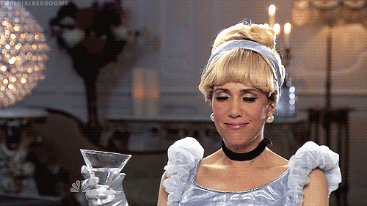
Impacts of reaction-gifs on non-digital communication
“Have you ever used the text of a reaction-gif in oral communication? If yes, which text was it?”
facepalm, I would apologize, but I don’t really give a…; Ain’t nobody got time for that shit.; I don’t believe you!; Lol; Look at the fucks I give; Perfection; Let's not play this game; You don't say; You're too precious for this world…

Slide 31
5. Visuality and time. Emoticons vs. reaction-gifs

Slide 32
 | Verbal (written) communication | Verbal smileys, inflectives, acronyms | Static emoticons | Dynamic emoticons | Reaction-gifs
Speed | slow | slow | fast | fast | fast
Visual c. | no | no | yes | yes | yes
Verbal c. | exclusively | exclusively | seldom | seldom | often
Unique-ness | completely unique | rel. well-elaborated list, but easily expansible | wide range of list, technical knowledge required to expand | wide range of list, technical knowledge required to expand | wide range of list, easily produced
Dynamic | no | no | no | yes | yes
Charac-ters | - | - | drawn / graphic | drawn / graphic | generally real-life
Pop-/Sub-culture | no | no | seldom | seldom | often

Slide 33
Ágnes Veszelszki
www.veszelszki.hu
veszelszki.agnes@gmail.com

