Slide 3
Outline
Introduction, hypothesis
Definitions:
digital text, visual elements, non-linear reading, comics
A special way of reading: comics
Comparism: comic reading vs. digital reading
Summary, a prognosis for possible further research

Slide 4
Introduction
Visual elements which show up on digital interfaces have strong effects and influence on our cognitive processes, especially on reading and text comprehension. My aim is to get a better understanding on these elementary changes.
Questions:
Do we read in a new kind of way → therefore we need new types of texts?
Do we have new types of texts → therefore we need to read in new kinds of ways?
To answer these questions, I should find the common point of print and digital texts / print and digital reading.
Bevezetés, hipotézis

Slide 5
Hypothesis
Reviewing the related literatures about reading, text typologies and comprehension, I found a promising idea by Tamás Dunai (Médiakutató, 2007):
„Reading comics [from all the digital multimedia tools mentioned above] can be compared mostly to the active user activity of the Internet.”
My idea: What if I carry on this analogy in a much more focused way comparing the reading process of comics to the reading process of digital texts?
Hypothesis: reading digital texts including visual elements is a non-linear kind of reading which is similar to reading comics.
Bevezetés, hipotézis

Slide 7
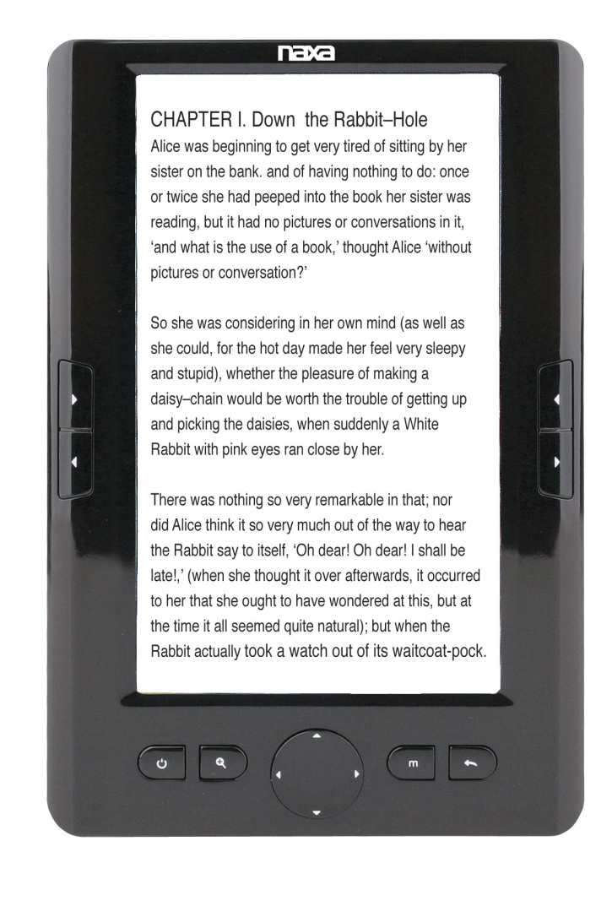
Digital texts
→ are every
texts stored as strings of characters in a technological device.
Digital texts are hypertexts: networks of web links which spread in the online space.
Digital texts are hybrid texts: design products for the readers.
→ Reading them is a constitutive, constructive and transforming process.
→ Syntax and semantics, such as cohesion and coherence function in a special form in them.

Slide 8
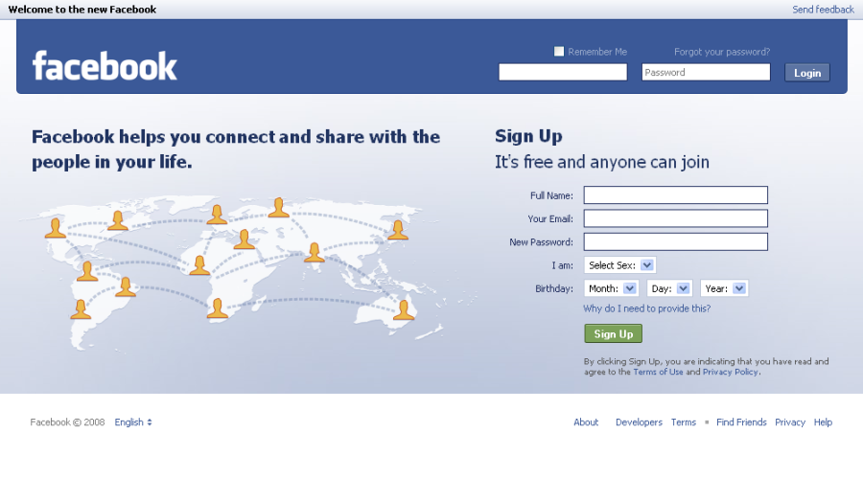
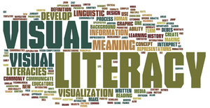
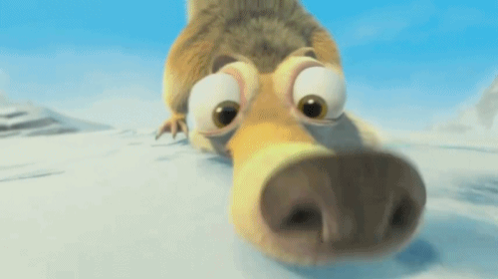
Visual elements
→ are all

Slide 9
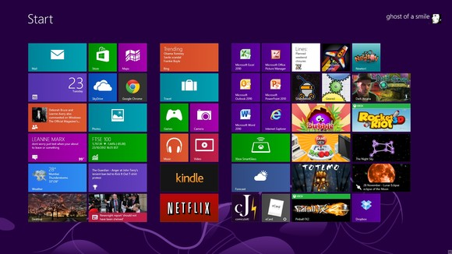
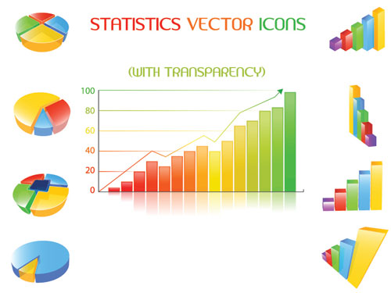
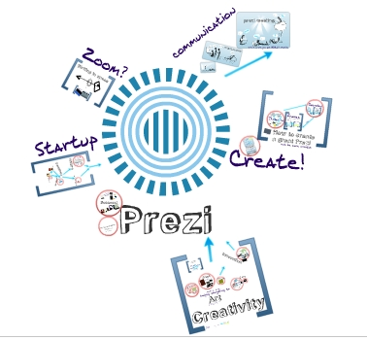
Visual elements
→ are all
visual contents which show up in the context of a text as additional, explicative or illustrative elements.

Slide 10
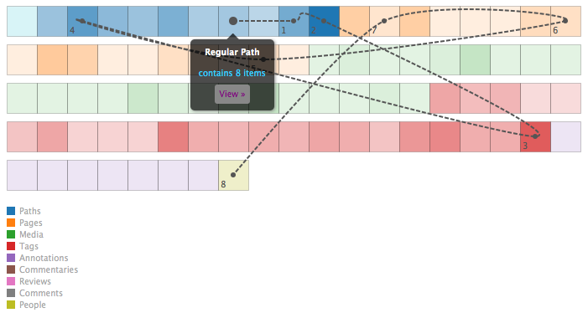
Non-linear reading
→ feature of digital texts
It is a fragmental, scanning, superficial, bouncing, simultaneous, information sorting, fast and pictorial reading, which concentrates on the individual elements and also on the users.
→ it facilitates primarily the rapid information searching, not the in-depht reading.
→ it was created as a result of the hypertext as a new reading strategy.

Slide 11
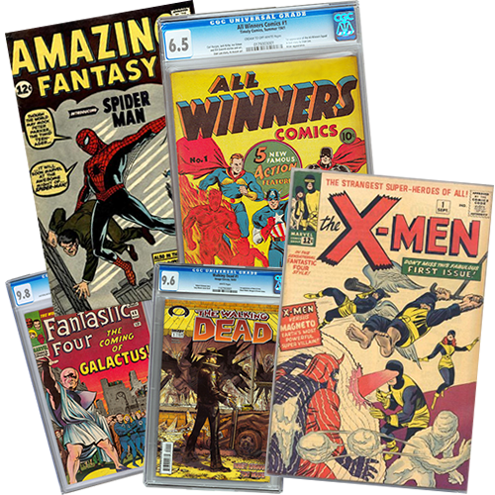
Comics
→literature + fine art
→medium + special reading
Texts + visual elements (pictures): coexist
Frames/panels: illustrate the story, facilitate comprehension, complete the meaning and make organic unit with it.
It may occur that:
text and pictures have got no sense without one another.
text and pictures communicate different things at the same time with the reader.
There are many types of comics according to cultures and languages, but in a basic level they share the same characteristics mentioned above.
= none of its narrative system is additional
= discovering narrative connection between the pictures

Slide 12
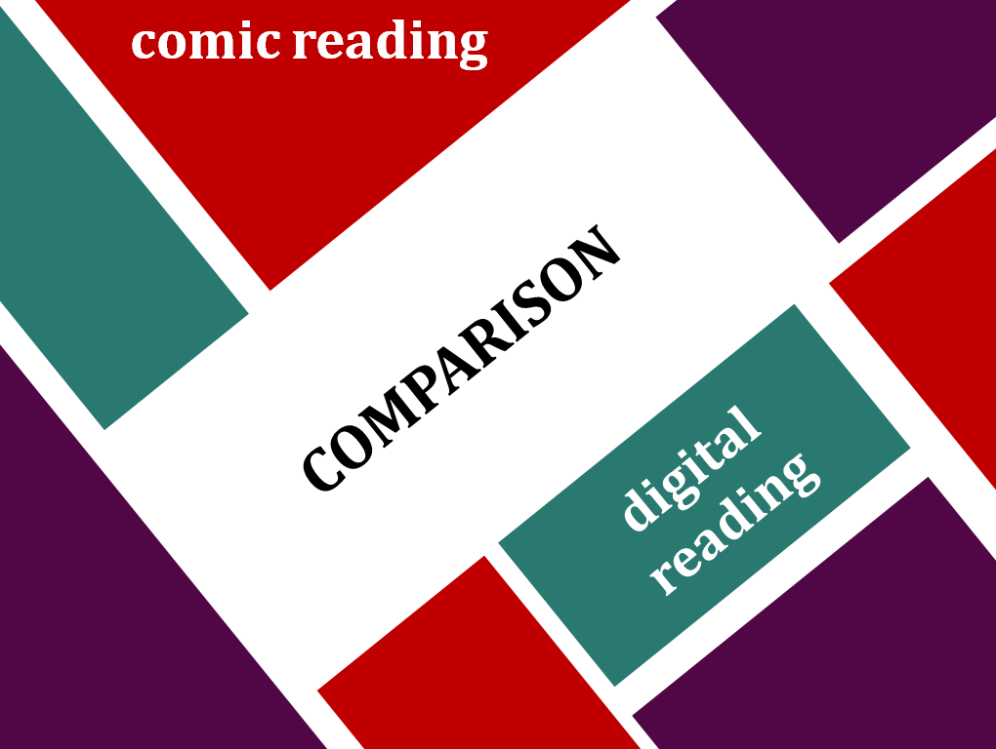

Slide 13
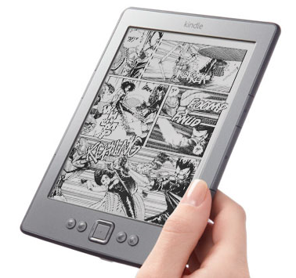
Comic
reading
Digital
reading
SIMILAR
PROCESSES
Fragmental, non-linear reading: not even the linear plot is cognizable in a linear way.
It depends on the reader whether s/he looks at the visual elements or the text firstly, or what part of the visual element s/he starts with.
Its elements are open and freely walkable by the reader.
„Hyperpicture”: web of pictures (webcomics).
„Hybridpicture”: design product with special cohesion and coherence.
Text inclusion needs an active user activity.
To understand and use the integration of pictures and text we need some certain visual literacy.

Slide 14
Comic
reading
Digital
reading
SIMILAR
PROCESSES?
Possible objections:
Comics are narrative texts, their aim is to tell a story, while digital texts have got numerous other functions and aims.
Reading process: reading a story, getting informed or acquire knowledge are not all the same processes.
HOWEVER
Further research is required!
Comics are increasingly used for dissemination and for illustrate educational materials.
That is: they could have not only narrative, but also descriptive, explicative and informative functions.

Slide 15
Conclusion
Modified hypothesis: reading digital texts including visual elements is a non-linear kind of reading which CAN BE similar to reading comics.
What follows from the comic book-like reading literacy?
Another step of mapping digital text inclusion processes.
The reconsideration of the development of writing digital educational materials.
Prognosis for possible further research

Slide 16
Bibliography
Aarseth, Espen J. (2004): Nem-linearitás és irodalomelmélet. Helikon Irodalomtudományi Szemle, 3. sz.
Allison Sivak (2003): Across Time and Space: Reading Comics. http://capping.slis.ualberta.ca/cap03/allison/workscited.htm. (Utolsó elérés: 2014. november 10.)
Dunai, Tamás (2007): Képregény Magyarországon. Médiakutató, 2007. tavasz. http://www.mediakutato.hu/cikk/2007_01_tavasz/02_kepregeny_magyarorszagon. (Utolsó elérés: 2014. november 10.)
Eve Bearne, C hris C lark, Annette Johnson, Penny Manford, Marilyn Mottram, and Helen Wolstencroft with Rosemary Anderson and NikkiGamble, 2007. Reading on screen. Leicester: United Kingdom Literacy Association.
Hargittai Eszter: Second-Level Digital Devide: Differences in People’s Online Skills. , First Monday, 7. évf. 4. sz. 2002. 04. 01.
Jay Bolter, 1991. Writing space: The computer, hypertext, and the history of writing. Hillsdale, N.J.: Lawrence Erlbaum.
Jay Bolter, 2001. Writing space: The computer, hypertext, and the remediation of print. Second edition. Mahwah, N.J.: Lawrence Erlbaum.
Koós, István (2004): A képregény mint sajátos kifejezési forma. Kalligram. XIII. évf. 2004. február. http://www.kalligram.eu/Kalligram/Archivum/2004/XIII.-evf.-2004.-februar/A-kepregeny-mint-sajatos-kifejezesi-forma. (Utolsó elérés: 2014. november 10.)
Kovács, Nóra (é. n.): WebcoMix: Képregények az interneten. http://epa.oszk.hu/01500/01515/00006/pdf/mediarium-iii_3-4_07.pdf. (Utolsó elérés: 2014. november 10.)
Maksa, Gyula (2007): Ismeretterjesztés és képregény. Médiakutató, 2007. tavasz. http://www.mediakutato.hu/cikk/2007_01_tavasz/01_ismeretterjesztes_es_kepregeny. (Utolsó elérés: 2014. november 10.)
Mary C . Dyson and Gary J. Kipping, 1998. “Exploring the effect of layout on reading from screen,” In: Roger D. Hersch, Jacques André, and Heather Brown (editors). Electronic publishing, artistic imaging, and digital typography: Seventh International Conference on Electronic Publishing: Proceedings. Berlin: Springer–Verlag, pp. 294–304.
Mary C . Dyson, 2004. “How physical text layout affects reading from screen,” Behaviour & Information Technology, volume 23, number 6, pp. 377–393.
Maurizio Gentilucci and Michael C . C orballis, 2006. “From manual gesture to speech: A gradual transition,” Neuroscience and Biobehavioral Reviews, volume 30, number 7, pp. 949–960.
Nyíri, Kristóf (é. n.): A multimedialitás ismeretfilozófiája. http://www.phil-inst.hu/uniworld/kkk/mm/mm.htm. (Utolsó elérés: 2014. november 10.)
Razia Pullen -Technology Tools for Reading – Technology Tips for Differentiated Instruction. JRF/2006 p. 2 of 2. http://www.westedrtec.org/techtips. http://www.broward.k12.fl.us/studentsupport/ese/PDF/Whatisdigital.pdf. (Utolsó elérés: 2014. november 10.)
Sivak, Allison (2003): Across Time and Space: Reading Comics. http://capping.slis.ualberta.ca/cap03/allison/mainstream.htm. (Utolsó elérés: 2014. november 10.)
Terje Hillesund: Digital reading spaces: How expert readers handle books, the Web and electronic paper, First Monday, 15. évf. 5. sz. 2010. 04. 05.
William C. Dougherty: Managing Technology, The book is dead, long live the book! Available online 1 October 2011.
William C. Dougherty: Managing Technology, E-readers: passing fad or trend of the future? Available online 31 March 2010.
William C. Dougherty: Managing Technology, Meaning, technology, and the semantic web Available online 22 April 2008.
Thank you for your attention!

