Slide 1
Promiscuity of Images.
MEMES from an English-Hungarian Contrastive Perspective
Veszelszki, Ágnes
3rd Visual Learning Lab International Conference
Budapest, 07. 12. 2012

Slide 2
Agenda
internet memes as
conglomerates of image and text
Dawkins’ + Dennett’s
meme theory (memetics)
funny pictures + mutations = memes?
case studies:
  meme faces
  meme series: two sports events in 2012

Slide 3
Memetics
~
Meme Theory

Slide 4
Memetics = Meme Theory
evolutionary biology
  variability
  heredity/replication
  different suitability
memes: complex ideas:
  new-fangled replicators (Dawkins)
  units of cultural transmission / imitation

Slide 5
Memetics (Dawkins 1993, 2005, 2008)
requirements for spreading of
(biological & computer) viruses:
  (almost) identical copies of the information
  obey instructions
performed by
  genes in organisms
  programs on computers
“the human mind can be regarded as
a friendly environment for parasitic and
self-copying ideas and information,
minds can become really badly infected”
selfish gene:
  cultural phenomena become wide-spread
  not because they are true,
  but because they efficiently propagate themselves

Slide 6
Memetics (Dennett 1990, 2008)
units of replication
  mimemes / memes
  ~ gene, memory, Fr. même
examples: tunes, ideas, catch-phrases, clothes fashions, ways of making pots or of building arches
memes travel from mind to mind through imitation; leap promiscuously from vehicle to vehicle, from medium to medium
reason of their spreading:
  “replication is not necessarily for the good of anything”
  replication itself

Slide 7
Internet memes
Darwinian theory of evolution
Dawkins’ original concept of meme
cultural gene
unit of culture spreading through imitation
any type of picture, text, audio/video based content
which spreads in the internet

Slide 8
Internet memes
phenomenon, concept, text, picture or
the combination of text and picture;
spreads in the internet
content: joke, gossip, picture, web site,
web link and news/hoax…
gossip effect (~ orality)
topicality
immediate reaction to events
capability to spread rapidly:
social media (like, share, retweet, repin…)
collection of memes
  e.g.: 9gag.com, knowyourmeme.com, memebase.cheezburger.com, demotivation.us

Slide 9
Case studies

Slide 10
Case studies
picture-text combinations
impossible to understand
without background knowledge or
textual comment
examples:
  1. meme characters, meme faces
  2. European Football Championship
  3. London Summer Olympics

Slide 11
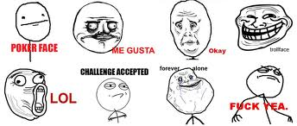
1. Meme faces

Slide 12
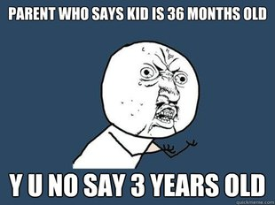
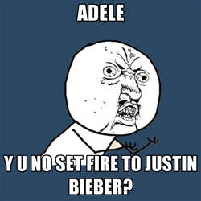
Y U No guy
I TXT U Y U NO TXT BAK? =
I text to you why don’t you text back?
(grammatically) incorrect language, abbreviations used in text messaging
reflect on political, social or popular culture issues: background knowledge

Slide 13
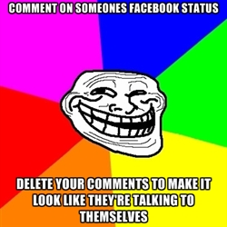
Trollface
trolling: destructive behaviour,
disturb multi-participant virtual communications, insulting remarks, irrelevant comments
cheeky wink

Slide 14
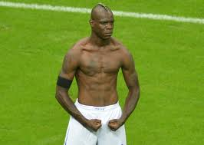
2. The Balotelli meme of the
European Football Championship 2012
Italian footballer Mario Balotelli, pose

Slide 15
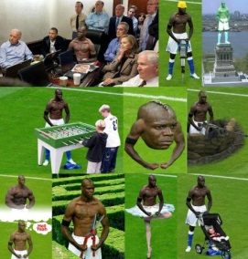
Balotelli Meme
30 examples > 5 textual information

Slide 16
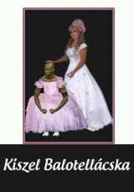
Balotelli: Hungarian example

Slide 17
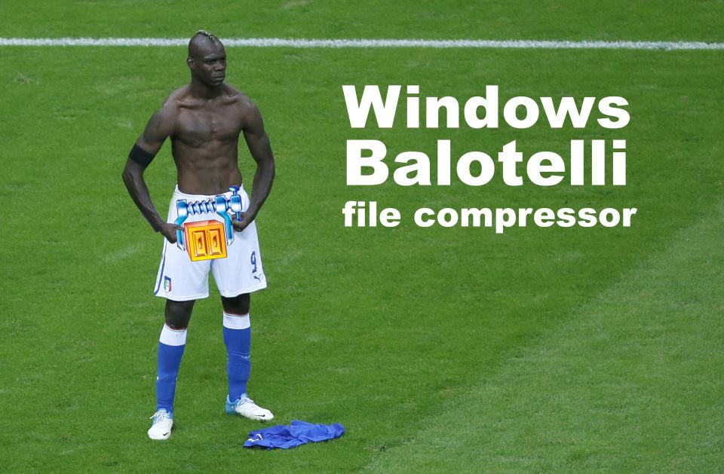
Balotelli: English example

Slide 18
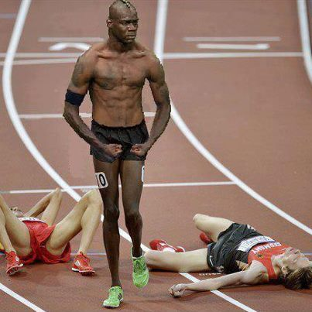
3. Memes:
London 2012 Summer Olympics
> 70 different Olympic memes

Slide 19
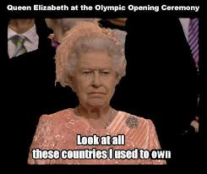
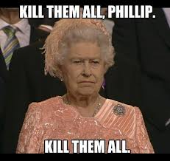
Olympics: the Queen

Slide 20
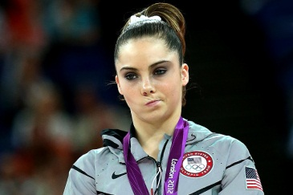
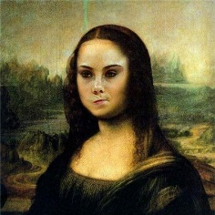
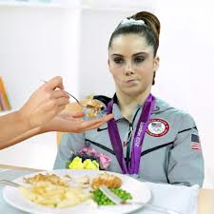
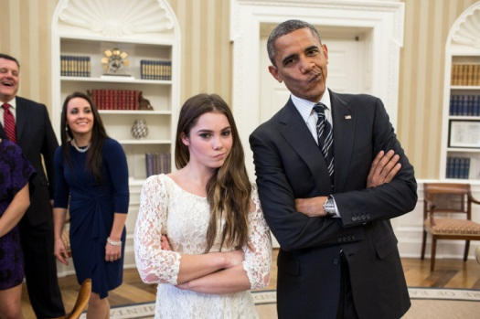
McKayla Maroney is not impressed

Slide 21
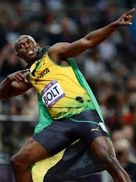
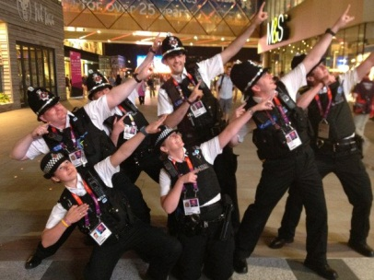
Bolting

Slide 22
Summary

Slide 23
Aims of producing internet memes
entertainment
humour
(9gag slogan: “Just for fun”)
mocking of a social-political phenomenon
advertising
community building
(cf. Nescafé)
mobilizing computer users
(cf. President Obama’s campaign)

Slide 24

All you need is like!
Thank you for your attention.
Ágnes Veszelszki, www.veszelszki.hu

